Slide 1

LIBRARY & KNOWLEDGE CENTER
http://library.binus.ac.id
Meiliana
LKC Manager

Slide 2
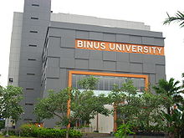
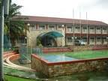
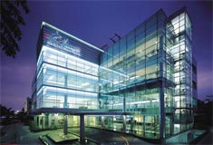

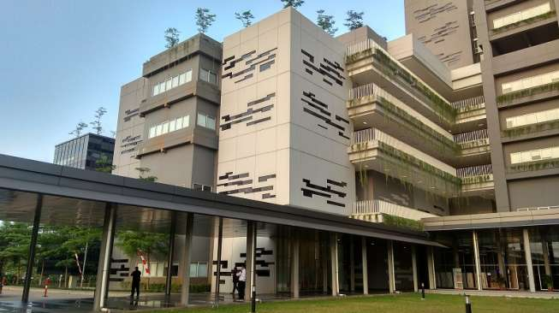
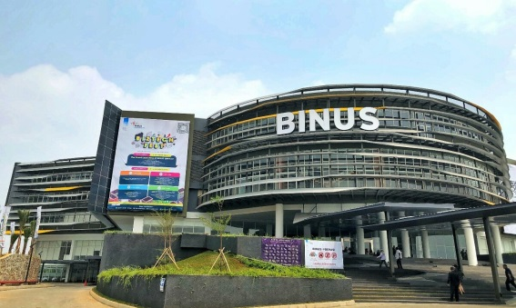
Locations
Library & Knowledge Center BINUS Locations
Anggrek Campus
1st Floor
Kijang Campus
2nd Floor
JWC Campus
4th Floor
FX Campus
6th Floor
Alam Sutera Campus
1st Floor
Bekasi Campus
3rd Floor
Intralibrary Loan -> Borrow / Return in any location

Slide 3




Library & Knowledge Center Contact
binus.library
library@binus.edu

Slide 4
LKC Service Hours
Location | Monday - Friday |  | Saturday
 | Reguler | Semester Pendek | Reguler | Semester Pendek
Anggrek | 08:00 - 19:30 | 08:00 – 18.00 | 08:00 - 17:00 | 08:00 - 15:00
Kijang | 08:00 - 17:00 | 08:00 - 15:00 | 08:00 - 17:00 | 08:00 - 15:00
Alam Sutera | 08:00 - 19:00 | 08:00 - 18:00 | 08:00 - 17:00 | 08:00 - 15:00
JWC | 07:00 - 21:00 | 07:00 - 21:00 | 09:00 - 17:00 | 09:00 - 17:00
FX | 09:00 - 17:00 | 09:00 - 17:00 | CLOSED | CLOSED
Bekasi | 08:00 – 18:00 | 08:00 – 18:00 | 08:00 – 15:00 | 08:00 – 15:00
Every Friday FX library is closed at 11.30 AM - 1.00 PM
Service hours could be adjusted, please the LKC website

Slide 5
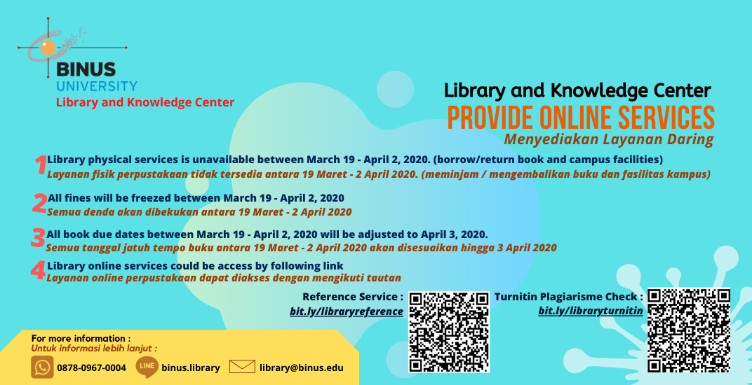
LKC Service Update (March 19 – April 19, 2020)

Slide 6
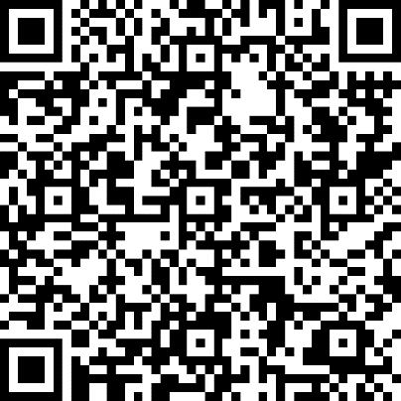
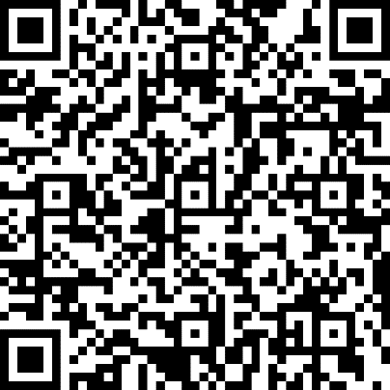
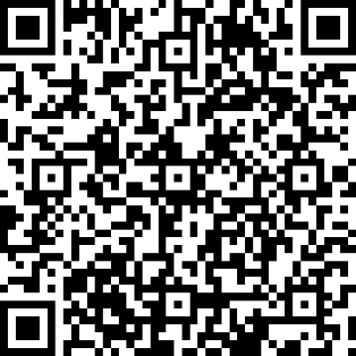
Online Services Library & Knowledge Center
Library Reference Services
Turitin Plagiarism Check
Book Delivery
(Borrow & Return)
Notes:
Book Delivery only available while employee not in WFH condition

Slide 7
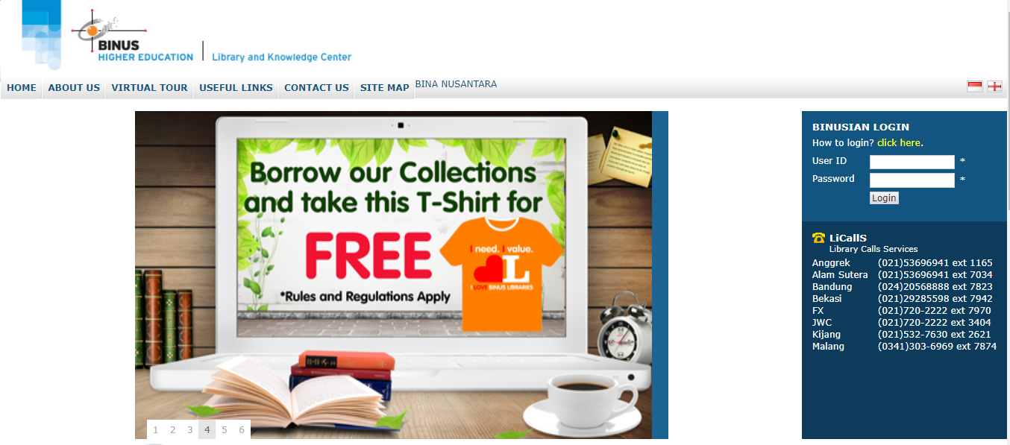
Website
LIBRARY WEBSITE
https://library.binus.ac.id/

Slide 8
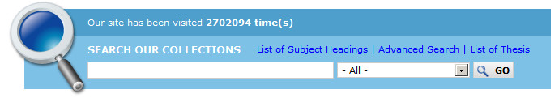
Online Public Access Catalog
Anggrek | Kijang | JWC | Alam Sutra | FX | Bekasi
In one INTEGRAGED DATABASE OF BOOK CATALOG
Search by
Title | Author | Publisher | Course Name | Course Code
Department | Advisors | Subject

Slide 9
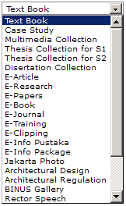
Available Resources
Books
Journals
Thesis S1, S2
Clippings
Information Packages
Papers, Research, Articles,
Proceedings, Case Studies
Multimedia
Architectural Design & Regulation
Binus Chronicles and Galleries

Slide 10
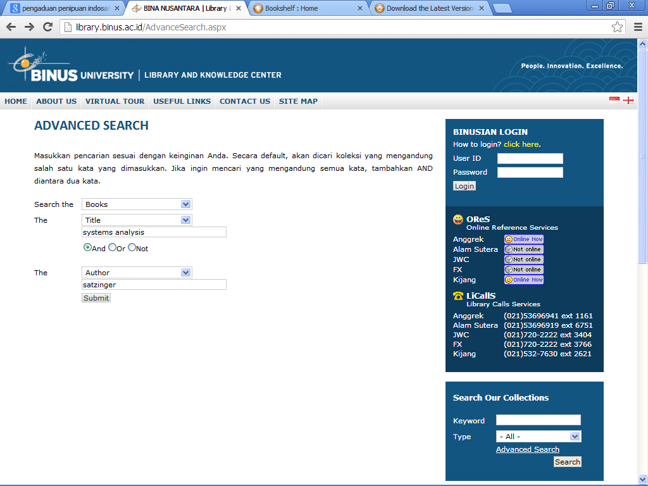
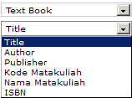
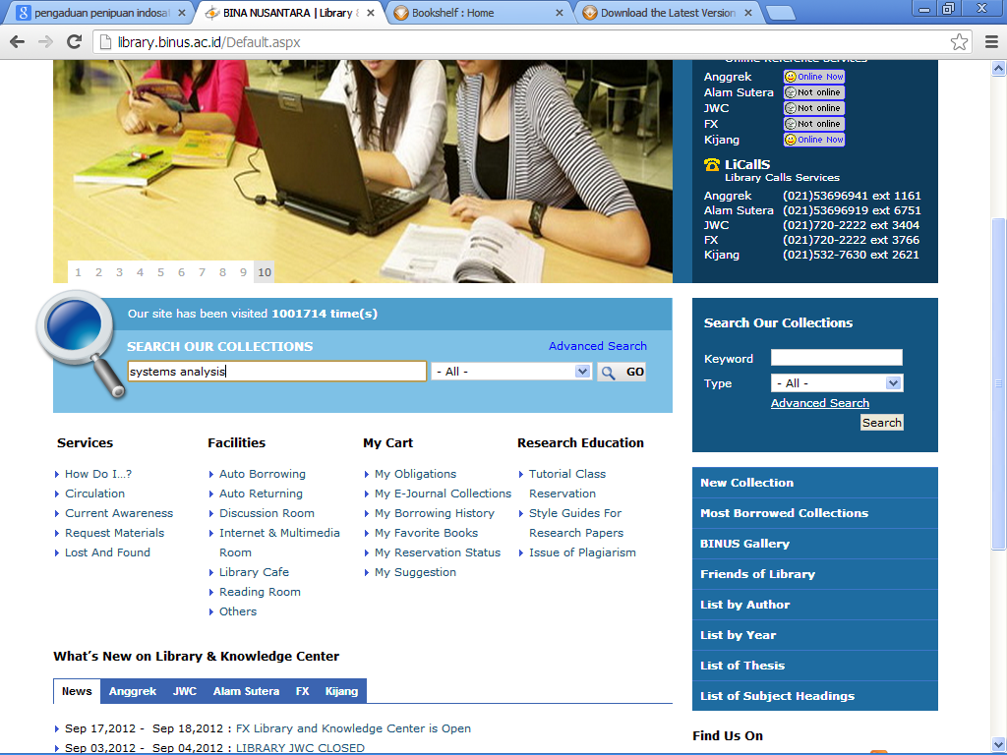
Advanced Search

Slide 11
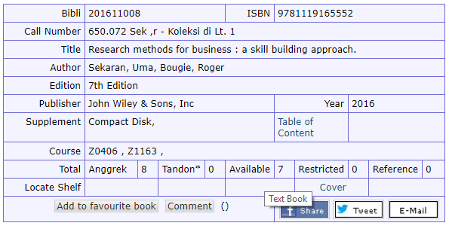
Search Results
Call Number:
650.072 Sek , r
Sek : Author (Sekaran)
r : Title (Research methods…)
Location
Anggrek, JWC, Kijang, Alsut, FX, Bekasi
Availability ; Type of Collections
Book Cover

Slide 12
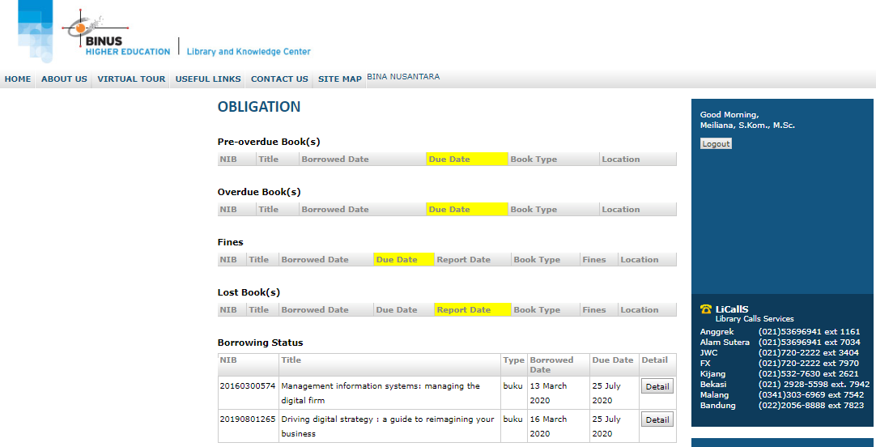
Obligation / Personal Chart
Information about your obligation will be sent as well to your email address.

Slide 13
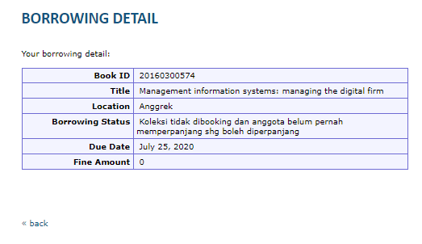
Renewal

Slide 14
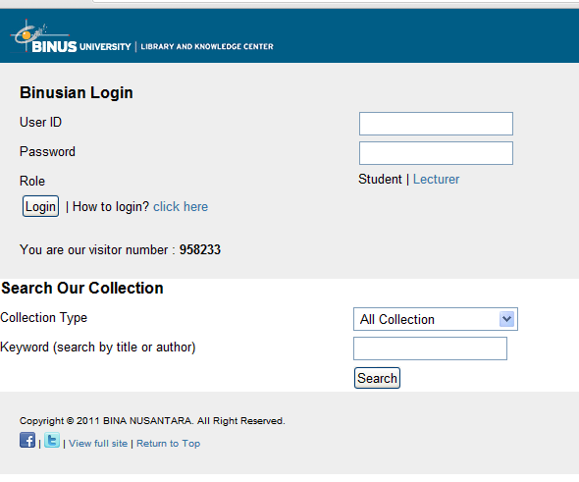
Mobile Website
http://m.library.binus.ac.id

Slide 15

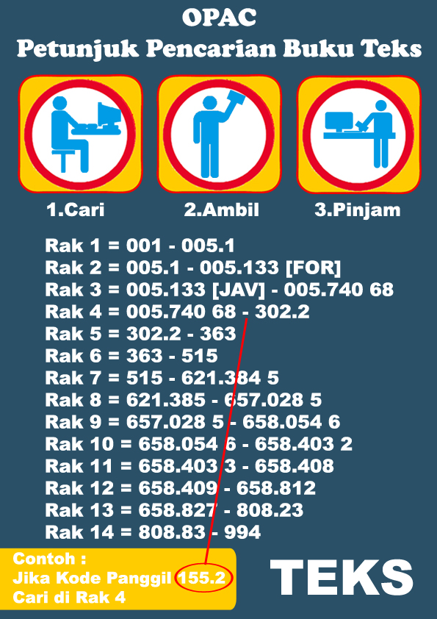
Locate Shelf

Slide 16
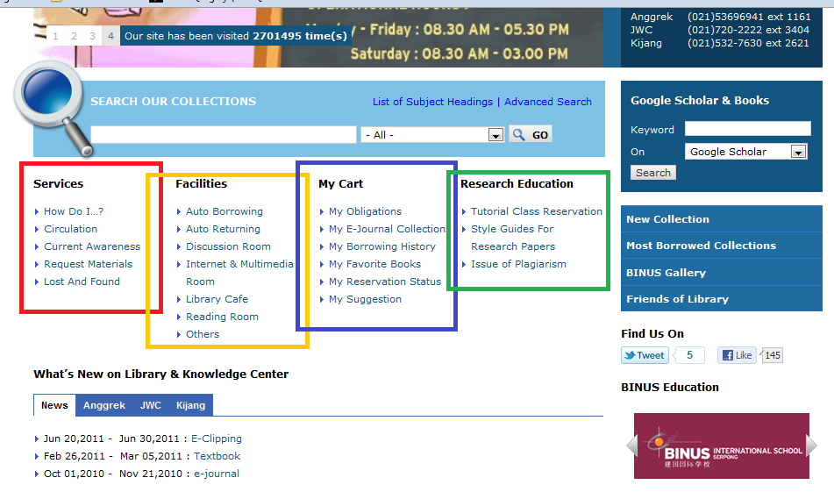
Services Facilities My Cart Research Education

Slide 17
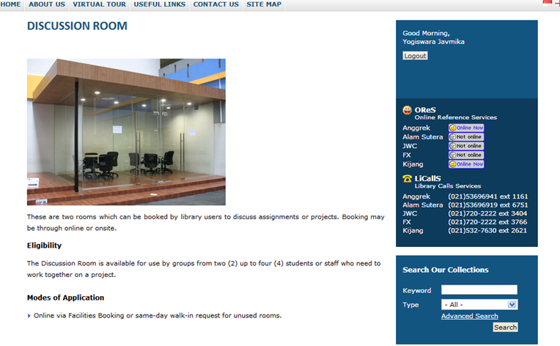
Discussion Room
Reservation of discussion room must be Online

Slide 18
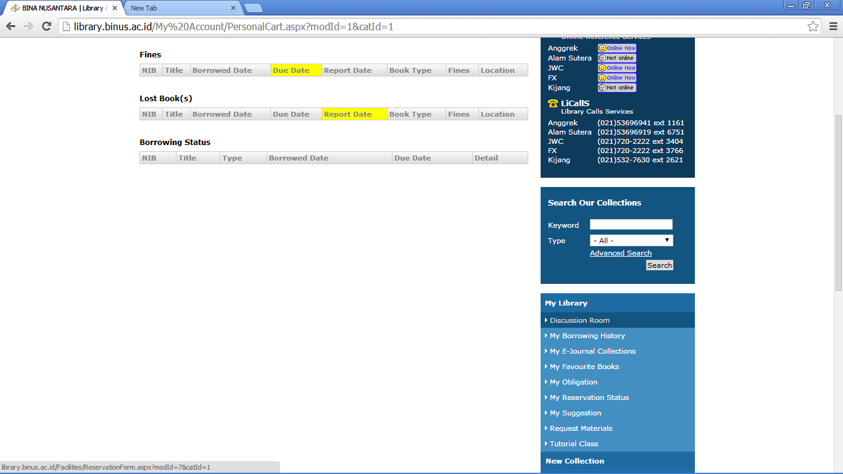
Discussion Room

Slide 19
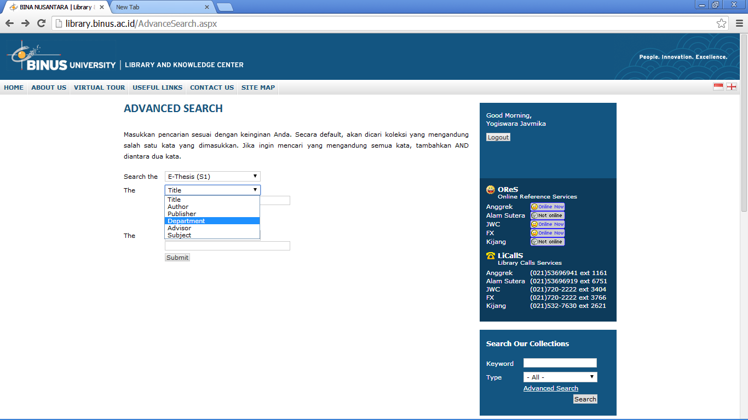
E-Thesis

Slide 20
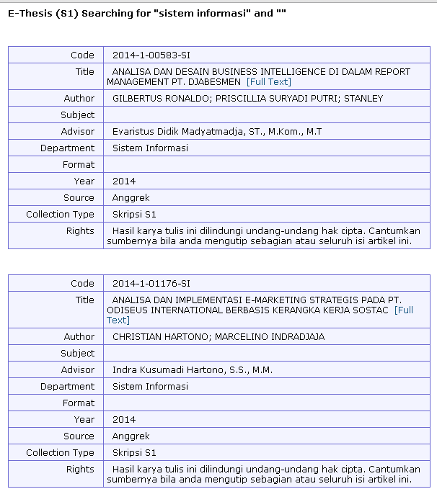
Search Result

Slide 21
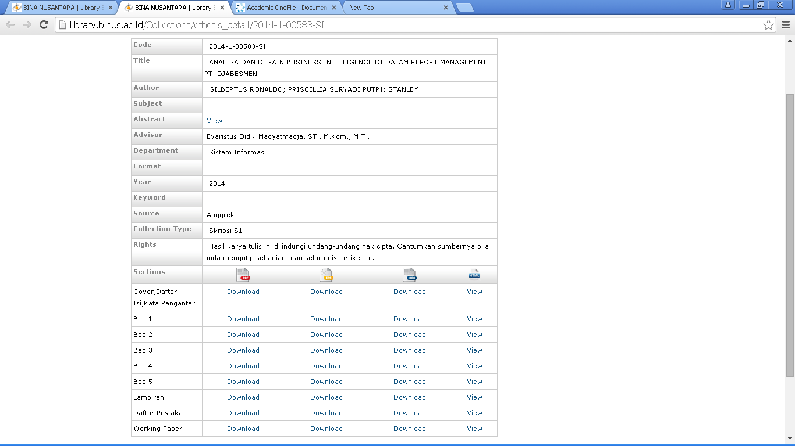
Full Text Access

Slide 22
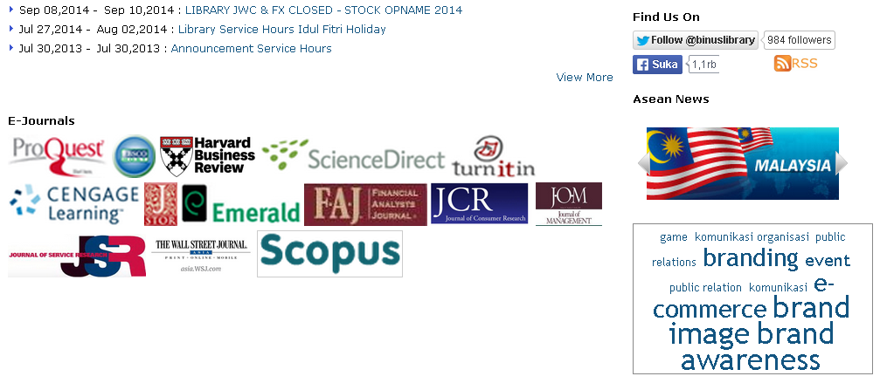
Electronic Journals
Electronic Journals
Click the Icon to Access

Slide 23
Access
In Campus
Off Campus

Slide 24
Off Campus Access
You need to have a Username and Password to Access Proquest from Outside the Campus Area.
You can get the password from the Library & Knowledge Center Website: http://library.binus.ac.id/
Log in – My Library – My EJournal Collections

Slide 25
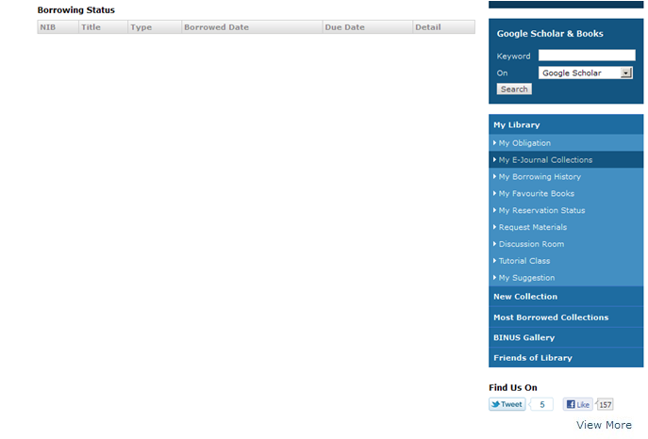
My Electronic Journal Collection Tab

Slide 26
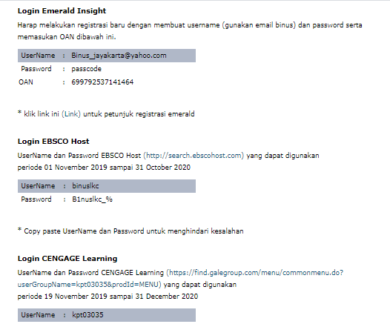
Usernames and Passwords

Slide 27
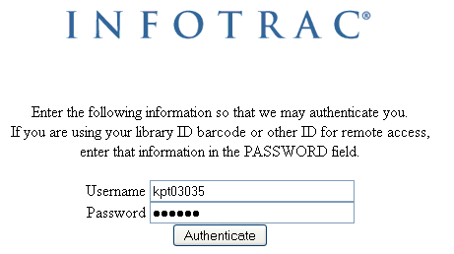
CENGAGE Logon Page

Slide 28
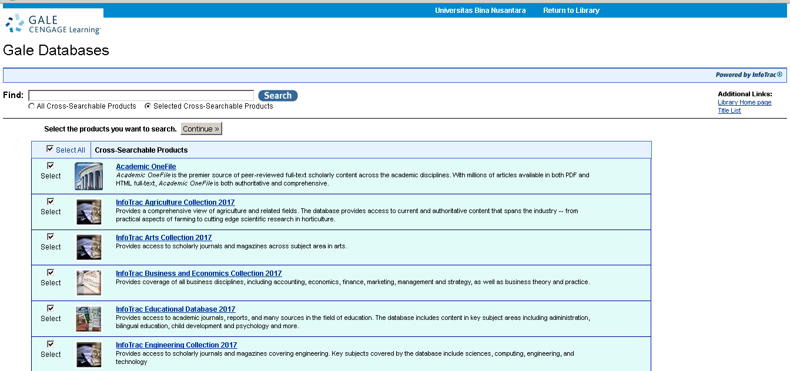
Cengage Database Home Page

Slide 29

E-JOURNALS
go to
http://perpusnas.go.id/beranda/
and
click e-resources menu

Slide 30
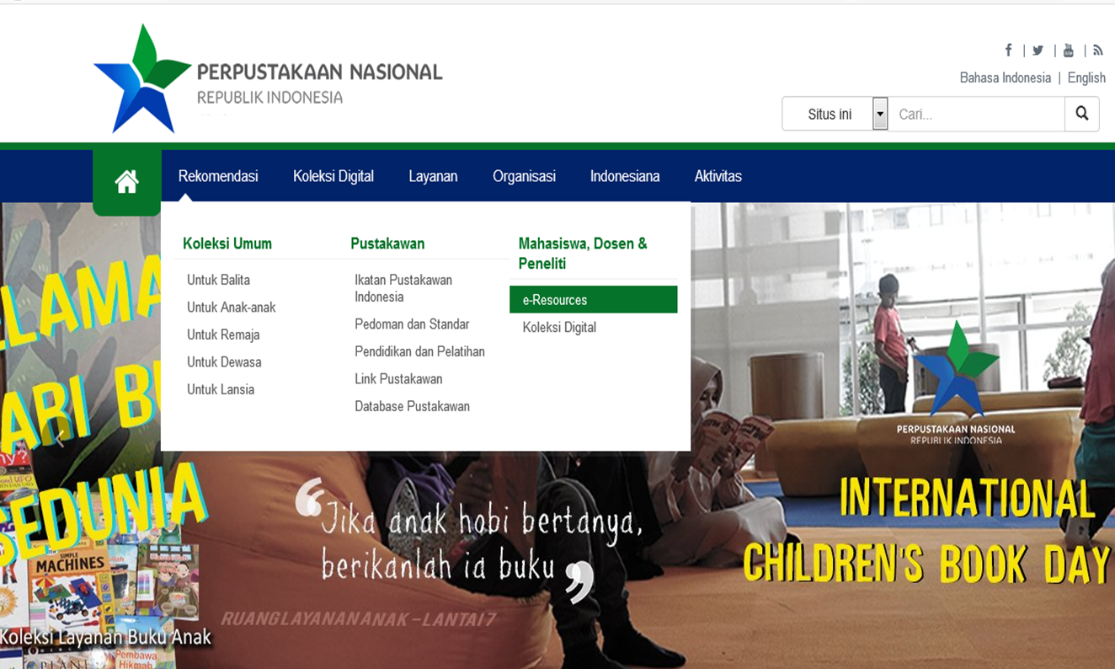

Slide 31
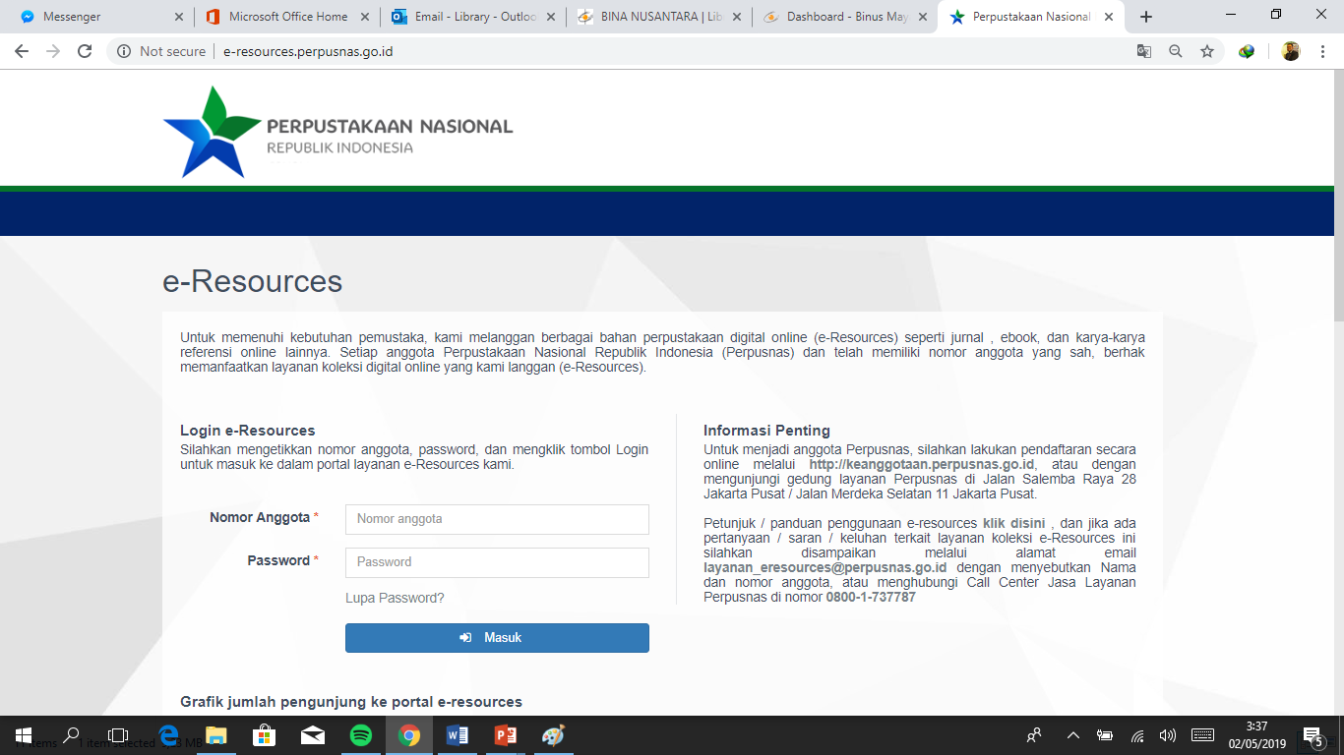
e-Resources National Library

Slide 32
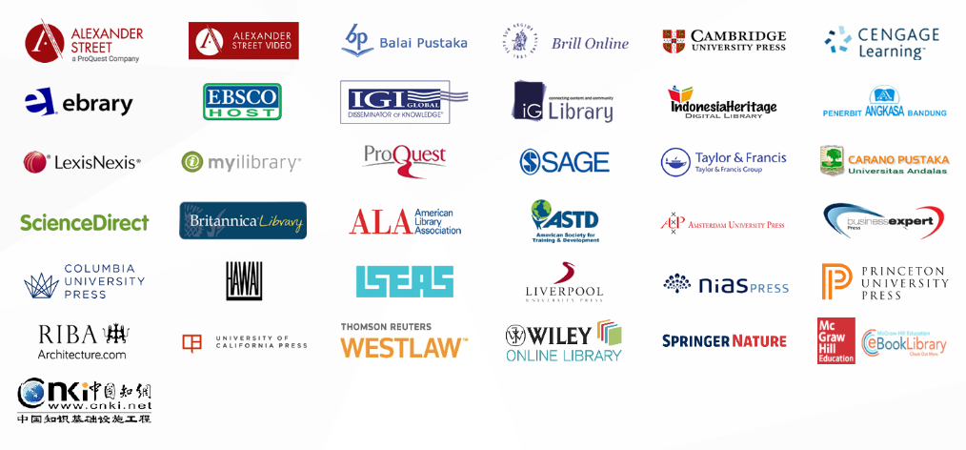
e-Resources National Library (2)

Slide 33
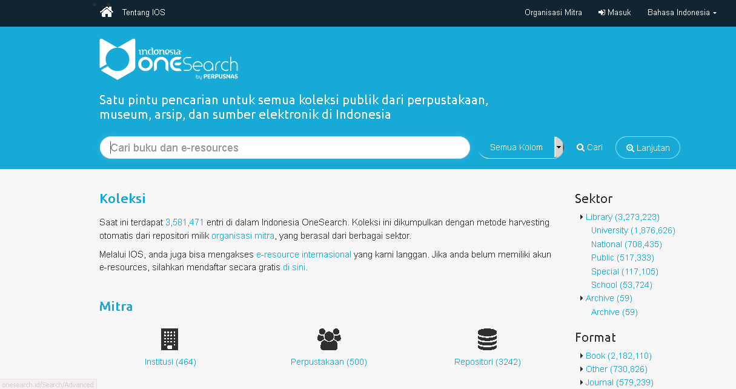
Indonesia One Search
http://onesearch.id/

Slide 34
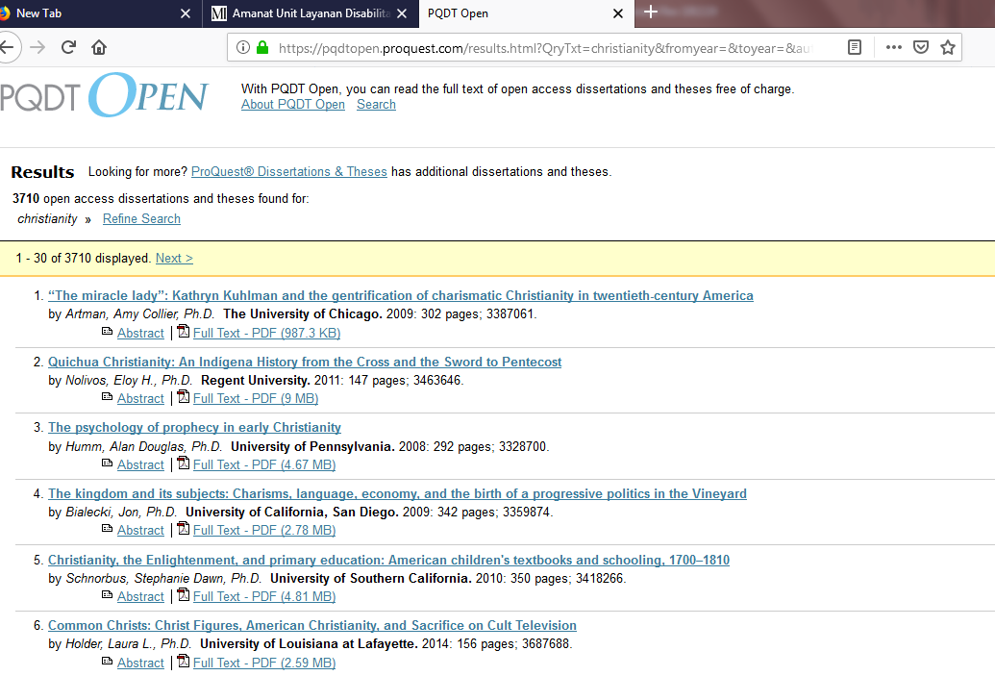
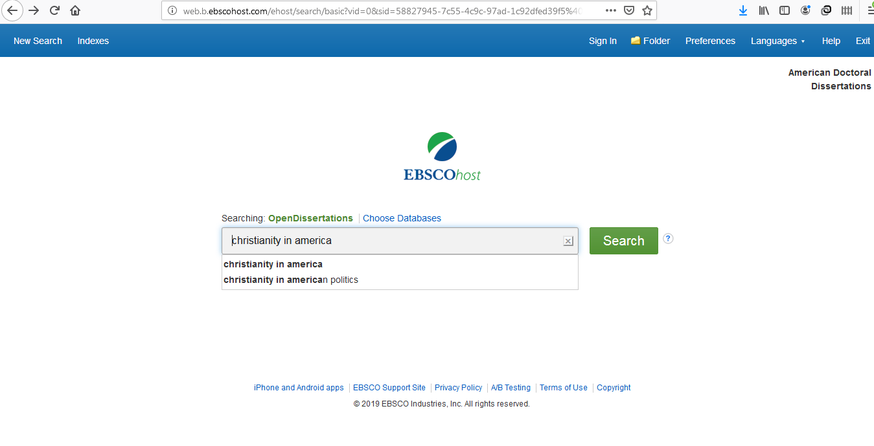
Open Dissertations Collection
American Doctoral Dissertations
http://www.opendissertations.com
PQDT Open Online https://pqdtopen.proquest.com

Slide 35
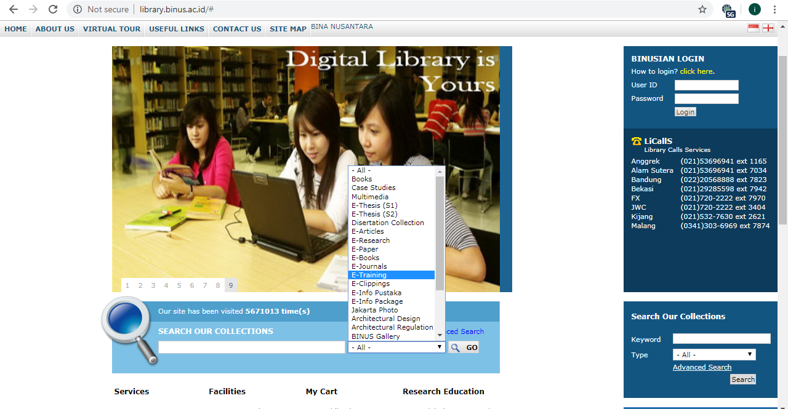
Library Website
Create – Disseminate – Manage – Store – Refine - Capture

Slide 36
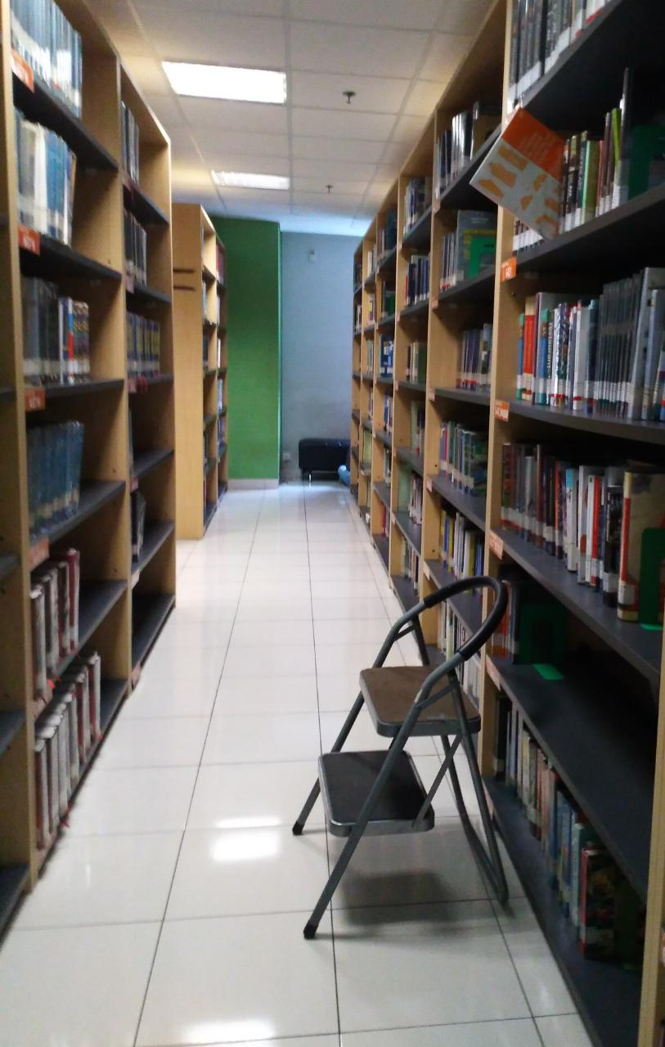
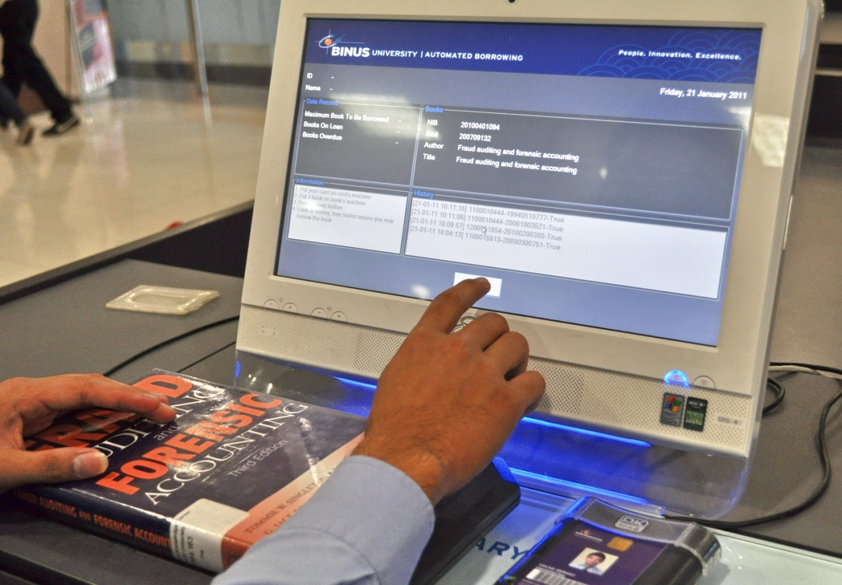
Library Circulation Services
Auto Borrowing Machine

Slide 37

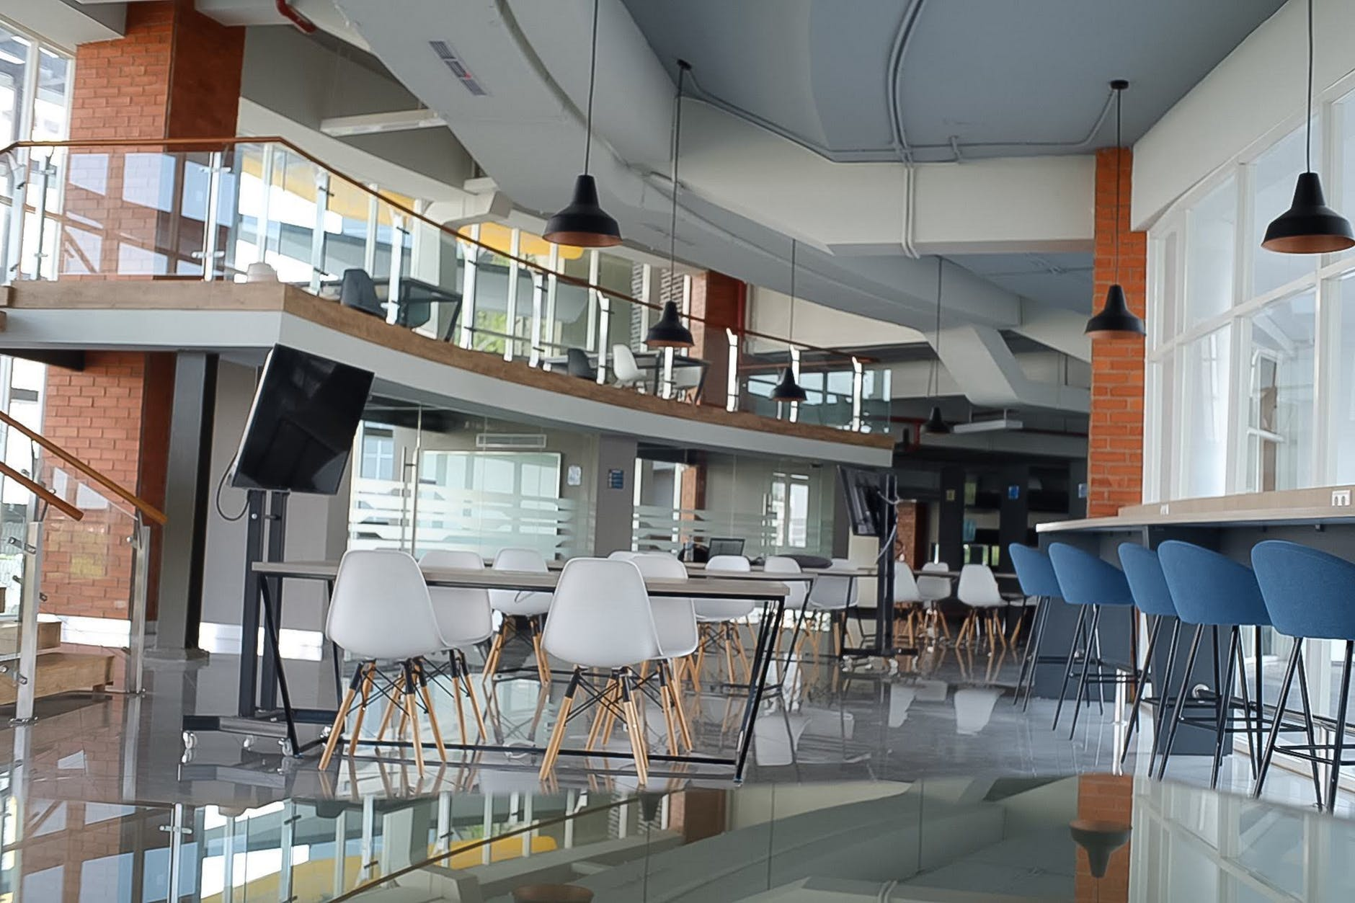
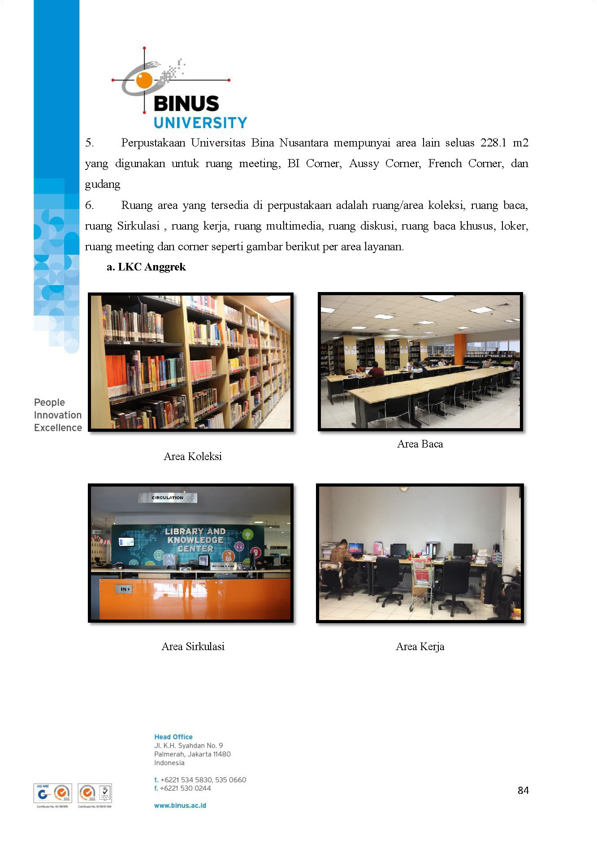
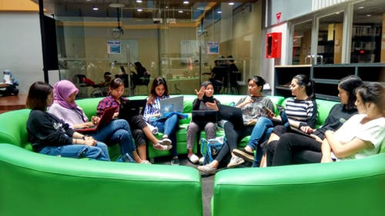

Slide 38

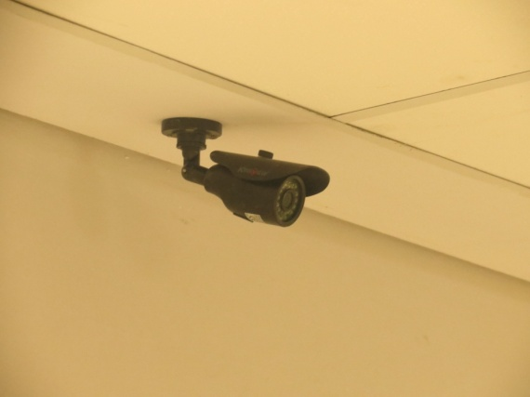
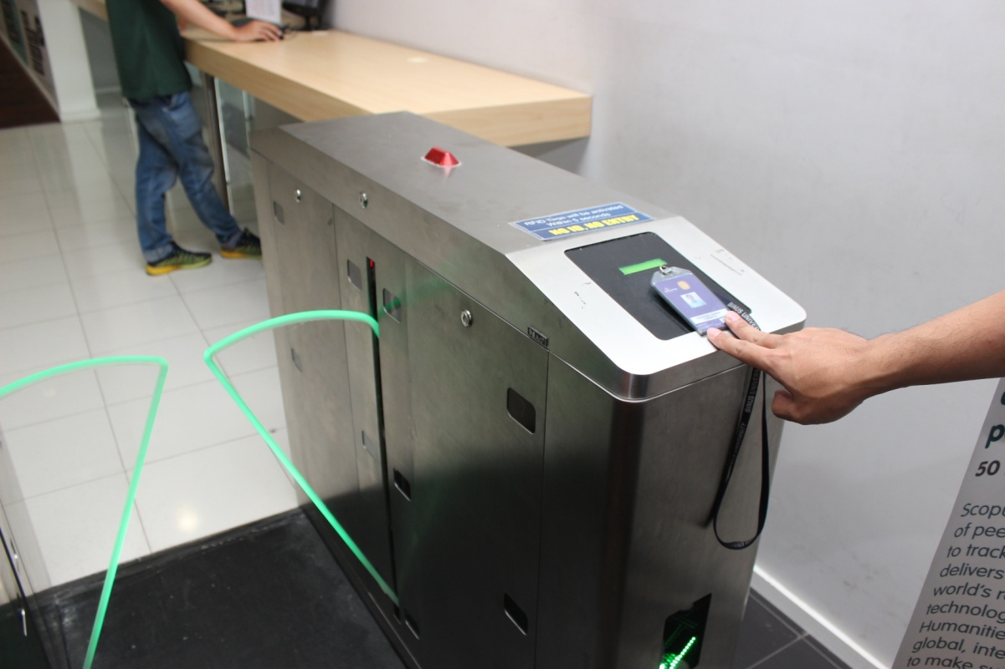
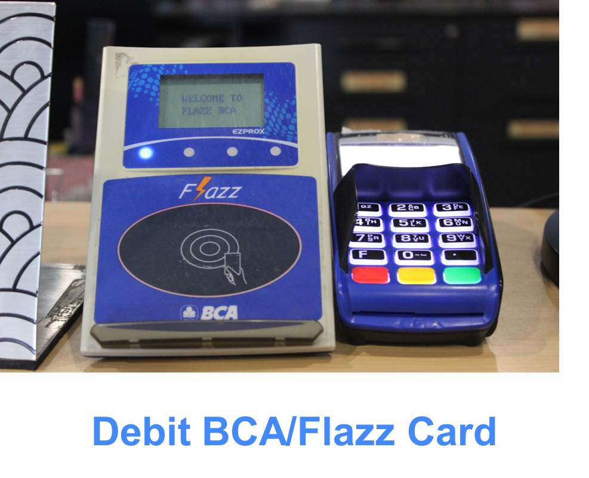


Technology in Use
Wifi Area
CCTV
Entrance Gate
Cashless Payment

Slide 39
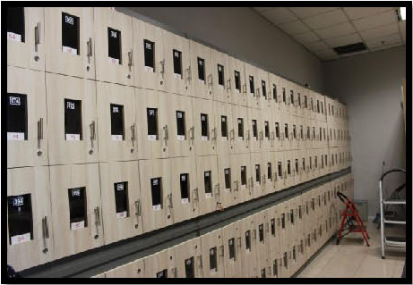
Locker and Circulation Area

Slide 40
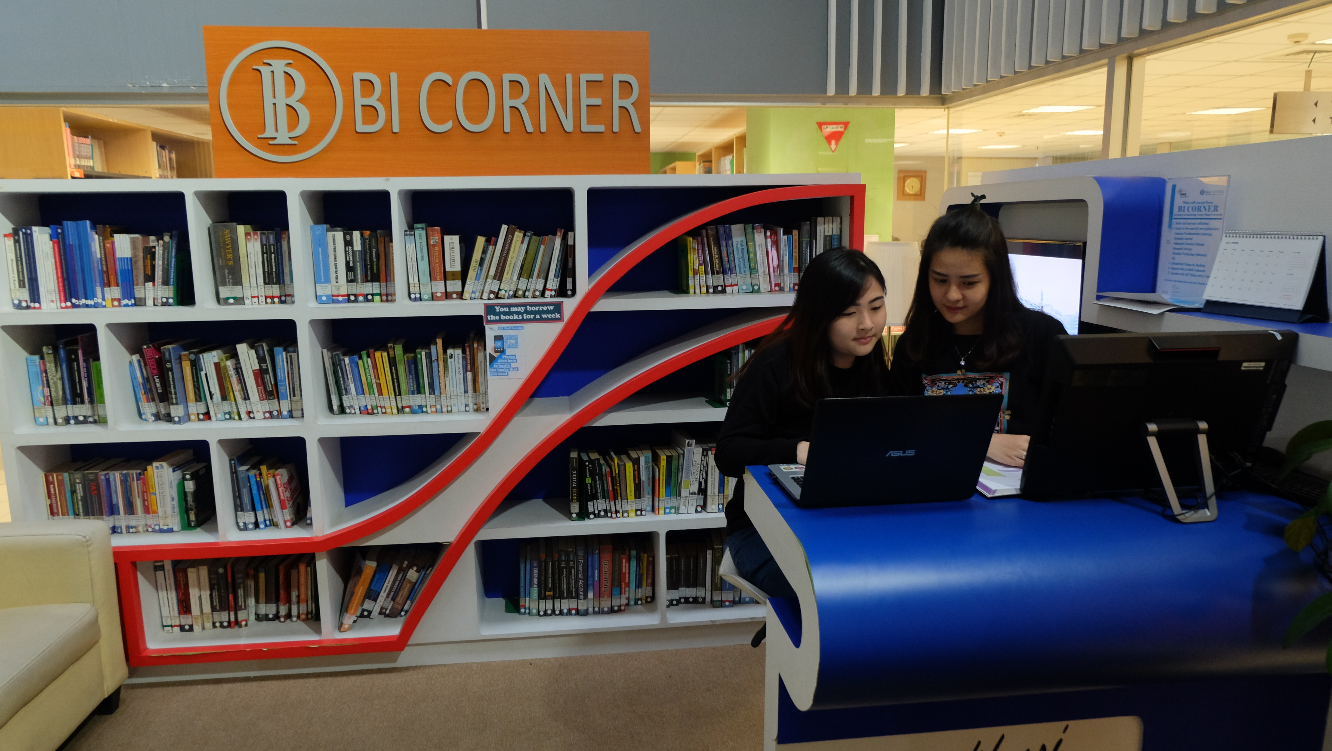
Collaboration: Bank Indonesia Corner

Slide 41
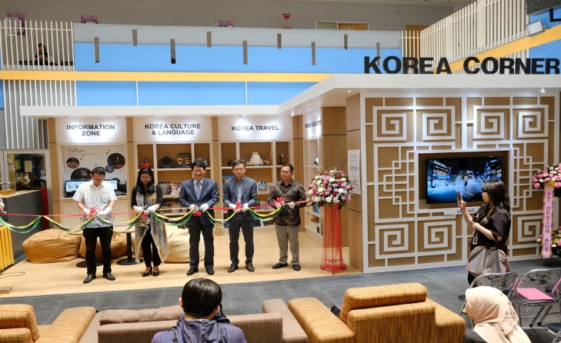
Collaboration: KOREA Corner

Slide 42
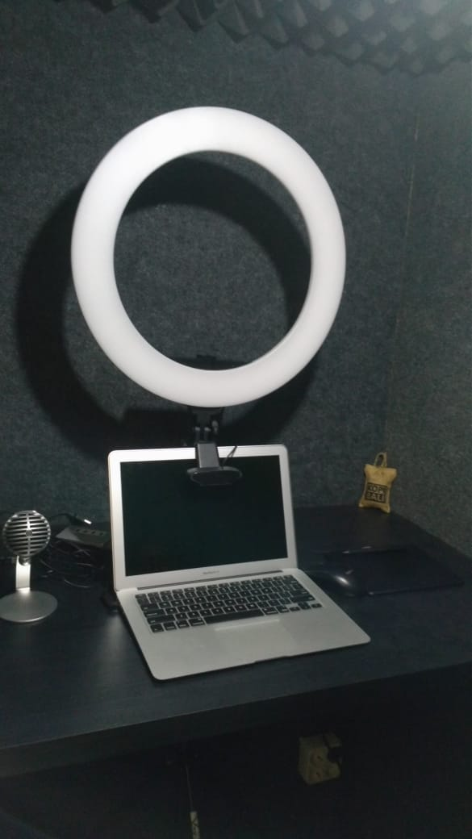


BeeBox Mini Studio
Devices in BEEBOX Studio
BEEBOX is an equipment provided by Knowledge Management & Innovation (KMI) to facilitate Binusian in creating a self-produced learning video. BEEBOX fits one person only, nevertheless it has the same complete tools as a multimedia studio. Binusian who utilizes BEEBOX can do alone both recording and shooting a learning video.
The devices will assist you to : record your face while explaining the content, record your voice for narrative audio, make a video with illustrations / concepts, make an interactive video (with BITS application. You can directly record video independently. The Knowledge Multimedia (KM) team will help with editing process after you finished recording.
See the Demonstration : https://youtu.be/yF613Mn1XqE

Slide 43

Thank You

